Slide 1
Mini-Project Progress Review 2
Project Title : Network Analyzer and Visualizer
Project Guide : Dr. Sivaraman E
Project Team ( Names & USN) : Vaibhav Raj (PES1UG19CS554)
Divyansh Raina (PES1UG19CS149)
Ashwin K (PES1UG19CS095)

Slide 2
Project Abstract and Scope
Provide a basic introduction of the Project
and also an overview of the scope it entails.
Inorder to provide a good internet connection , to ensure that all traffics are handled properly without any breakdown in a cost effective manner

Slide 3
Suggestions from Review - 1
Provide the suggestions and remarks given by
the panel members.
Mention the feasibility on the same showing
the progress.

Slide 4
Detailed Literature Survey
Scaling up an Edge Server Deployment-by
Lauri Loven ,Tero Lahderanta,Leena Ruha,Teenu Leppanen,Ella Peltonen
Wireshark For Security Professionals-Jessy Bullock
Day by day the network traffic coming to a server is increasing due to rise of pervasive computing and incoming 5G technology
The current cloud computing scenario may not provide enough computing capacity to manage latency and performance requirements set by modern pervasive computing systems

Slide 5
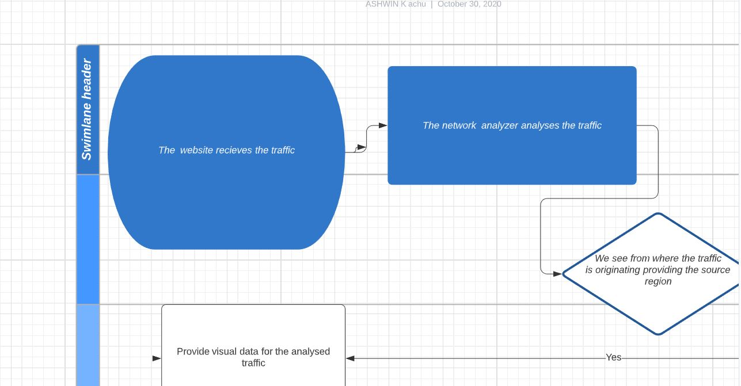
System Design

Slide 6
Technologies Used
What technologies you plan to use
and why ?
Recently neet result was out and like every year the server was down with in minutes . The total number of candidates applied for neet exam is more than 15 lakhs . But all of these students are not distributed equally in the country. The number of students in each state may vary . So we could try to reduce this problem if we could fix a edge server that too economically . That is we could analyze from which region the traffic is more and we could provide with an edge server to that region.

Slide 7
Project Progress so far
We have completed the most of the coding part , finished with the front end , integrating the network analyzer
We are working with the graphs to visualize the traffic.
We hope to finish the project in time.

Slide 8
Thank You

